Slide 1

RoarGraph: A Projected Bipartite Graph for Efficient Cross-Modal Approximate Nearest Neighbor Search
Meng Chen, Kai Zhang, Zhenying He,
Yinan Jing, X.Sean Wang
Fudan University

Slide 2
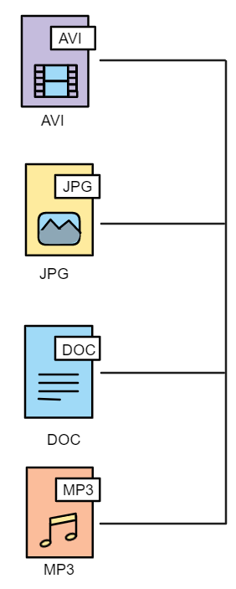
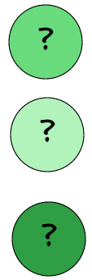
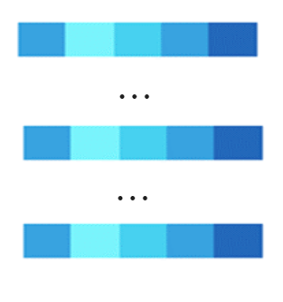
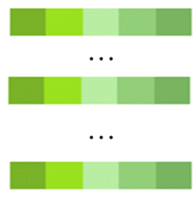
What is Approximate Nearest Neighbor Search (ANNS, Vector Search)
Unstructured
data
Unstructured
data
Vectors
Vectors
Transform into embeddings
Transform into embeddings
Base data
Queries

Slide 3


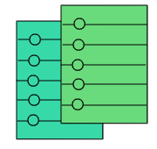
What is Approximate Nearest Neighbor Search (ANNS, Vector Search)
Transform into embeddings
Transform into embeddings
Build
Query
Base data
Approximate Nearest Neighbor Search
Queries
Vector Search:
Fast & Accurate
Measurements: Euclidean distance,
Cosine similarity,
Inner Product…
Top-k results

Slide 4
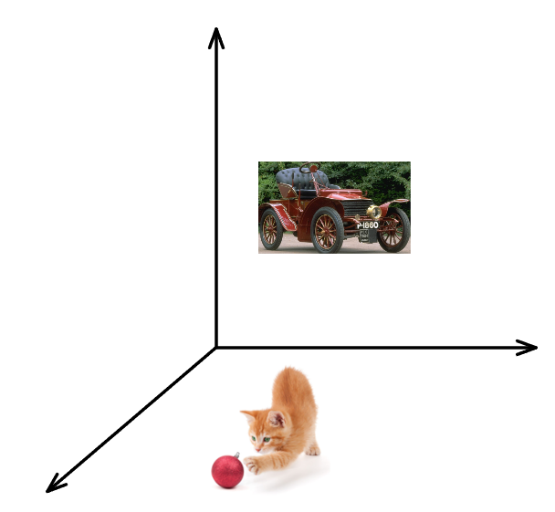
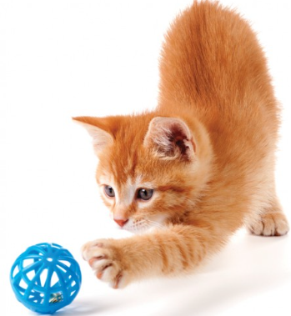
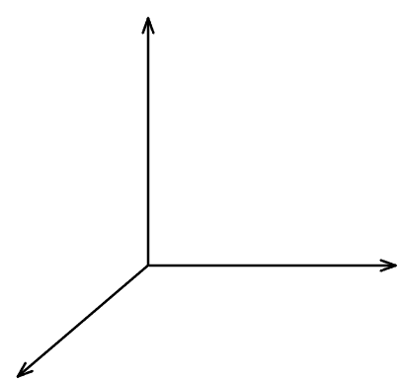
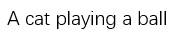
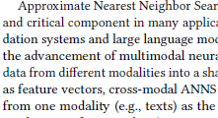
Single-Modal Search vs. Cross-Modal Search
Image Space
Image Query
Well-known indexes for single-modal ANNS:
HNSW,
Vamana
IVF
…
Nearest neighbor
Text Query
Kitten playing toy ball
Text Space
Nearest neighbor
Old car

Slide 5
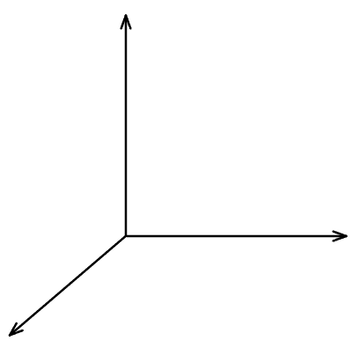

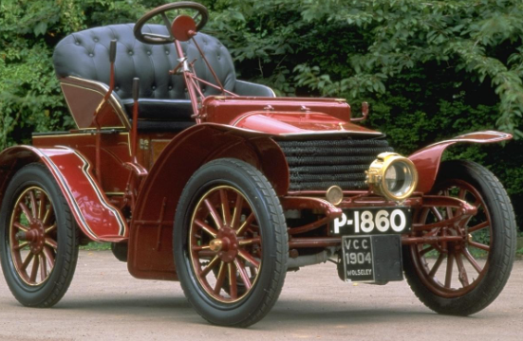
Single-Modal Search vs. Cross-Modal Search
Image Space
Shared Embedding Space
Text Space
Contrastive Learning
CLIP
ImageBind
…
Old car
Old car

Slide 6
Challenge & Motivation

Slide 7
Challenge & Motivation
Image Space
Shared Embedding Space
Modality Gap!
Liang, Victor
Weixin, et al.
Text Space
Contrastive Learning
CLIP
ImageBind
…
Old car
Old car

Slide 8

Challenge & Motivation
Base Data
Single-Modal Query
Cross-Modal Query
Modality Gap!
The Single-modal query is an
In-Distribution (ID) Query
The Cross-modal query become
Out-of-Distribution (OOD) query
Single-Modal Search
Cross-Modal Search
Same data distribution
Different data distribution

Slide 9
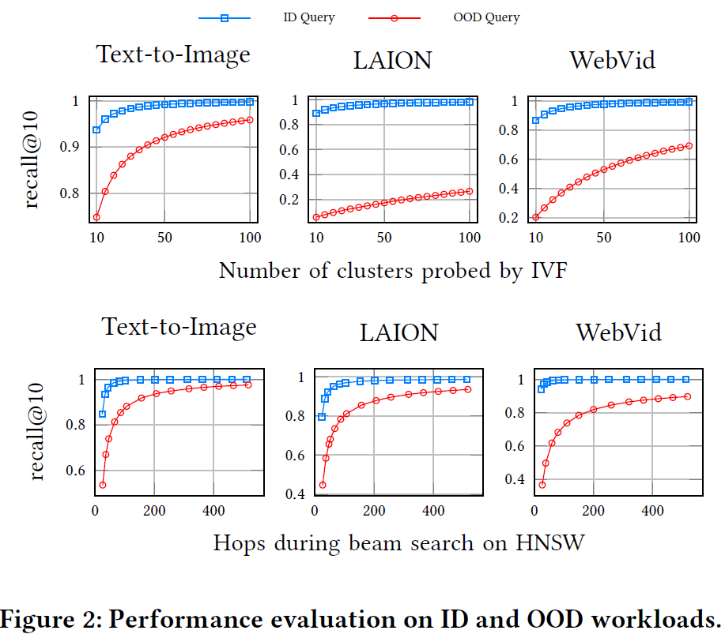
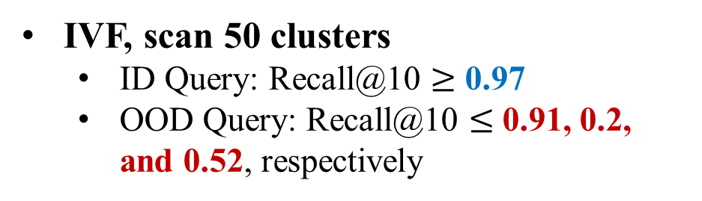
Low Performance of Existing Indexes in Handling OOD Queries
IVF, scan 50 clusters
ID Query: Recall@10 $≥$ 0.97
OOD Query: Recall@10 $≤$ 0.91, 0.2, and 0.52, respectively
HNSW
ID Query: around 48 hops to achieve recall@10≥ 0.93 on LAION dataset
OOD Query: around 500 hops
Low accuracy at the same computational costs.
Base data volume: 10M – 2.5M

Slide 10
Key Insights

Slide 11
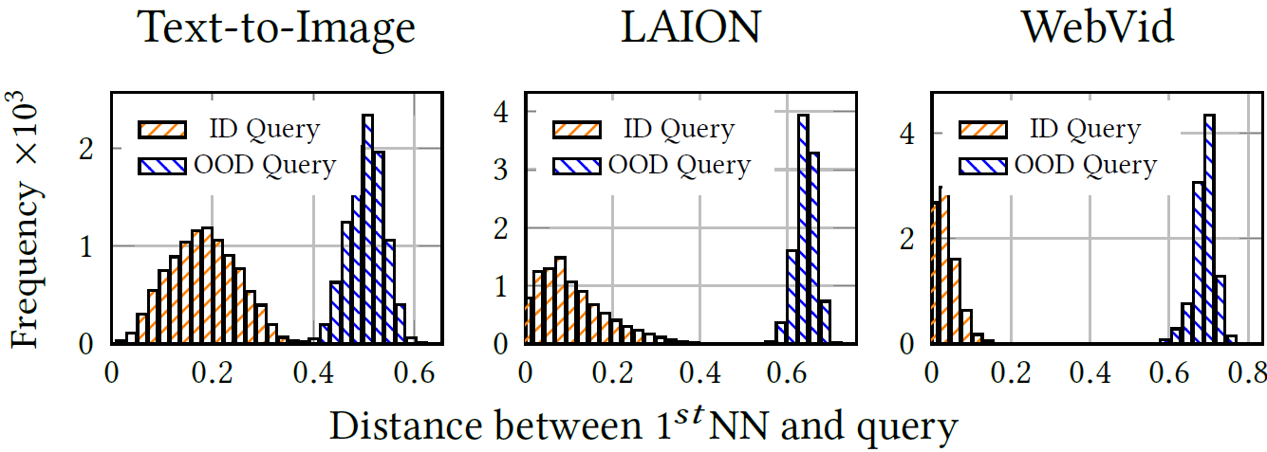
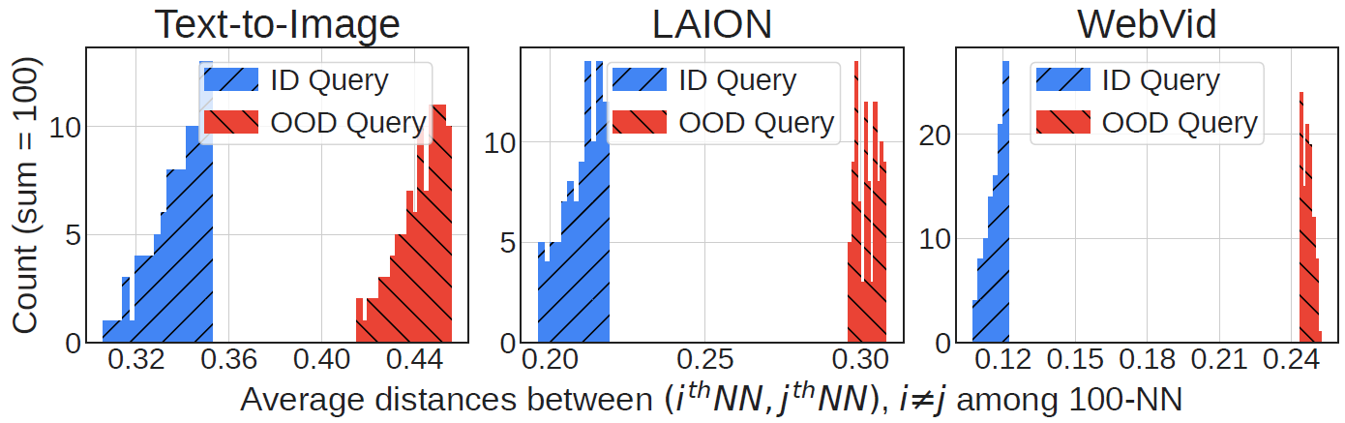
Key Insights
OOD queries are distant from their nearest neighbors
ID
OOD
The K-nearest neighbors of an OOD query are distant from each other in the high-dimensional space
ID
OOD

Slide 12
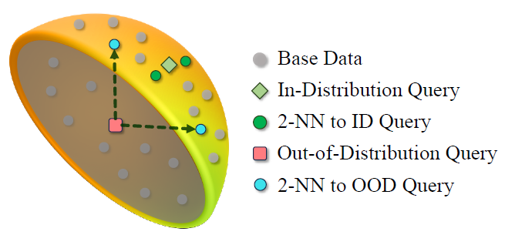
Key Insights
The surface of the sphere demonstrates the distribution of the base data.
ID

Slide 13
Key Insights
The surface of the sphere demonstrates the distribution of the base data.
ID
OOD

Slide 14
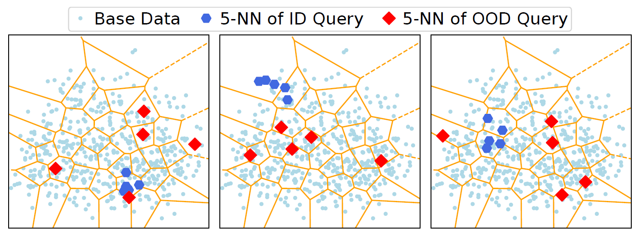
Key Insights
The surface of the sphere demonstrates the distribution of the base data.
ID
OOD
Voronoi Diagram

Slide 15
BREAK Existing Assumption!
Existing graph-based index:
Queries follow the same distribution of base data
Connect neighboring base vectors
OOD Query
ID Query
Quickly Converge and Reduce to a Small Search Space
Struggle to converge and Search Space Inflated

Slide 16
Method

Slide 17



Our Solution: RoarGraph - A Query Guided Graph
Key: spatially distant vectors but close from queries’ view
should be connected.
A
$${ Q}_{1}$$
B
B
B
C
E
C
E
C
$${ Q}_{2}$$
D
A
A
D
D
E
$${ Q}_{3}$$
F
G
F
G
F
G
Query-Base Bipartite Graph
Neighborhood-Aware
Projection
Connectivity
Enhancement
Projected Graph
RoarGraph

Slide 18



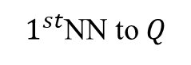

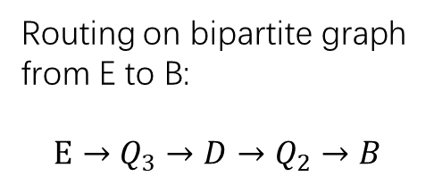


Query-Base Bipartite Graph: Utilizing queries to identify spatially distant vectors but close from queries’ view.
$1^{st}$NN to $Q$
A
A
$${ Q}_{1}$$
B
$${ Q}_{1}$$
B
Routing on bipartite graph from E to B:
$$E→Q_{3}→D→Q_{2}→B$$
Link query nodes
to top-N nearest base nodes
C
Link base nodes
to query nodes
C
$${ Q}_{2}$$
$${ Q}_{2}$$
D
D
E
E
$${ Q}_{3}$$
$${ Q}_{3}$$
F
F
Isolate Base Node
G
G
Query-Base Bipartite Graph
Query to Base Link

Slide 19
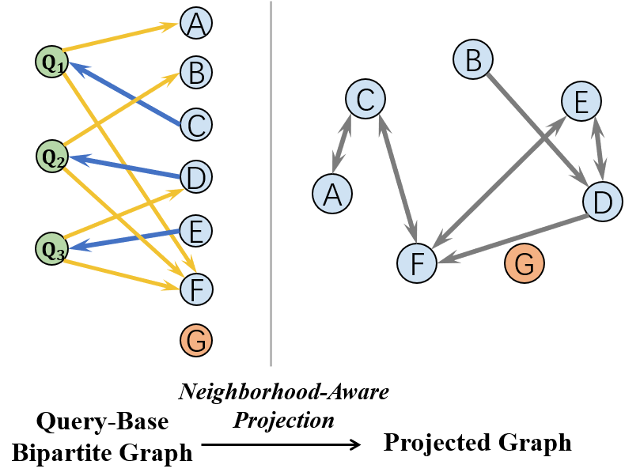
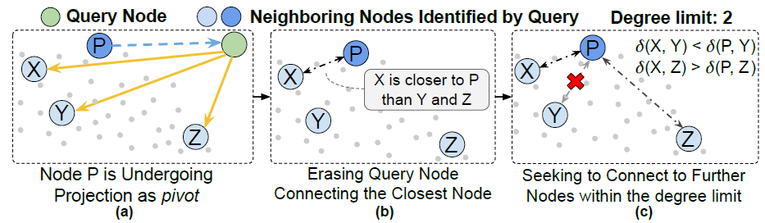
Projected Graph: better routing and memory efficiency
Neighborhood-Aware Projection:
Remove queries while keep neighboring relationship obtained from query distribution.

Slide 20
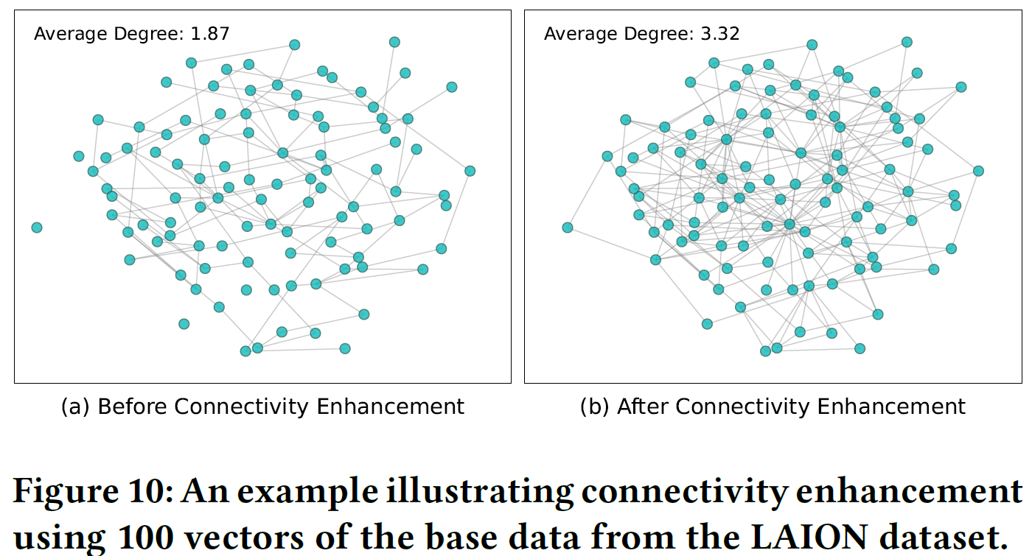
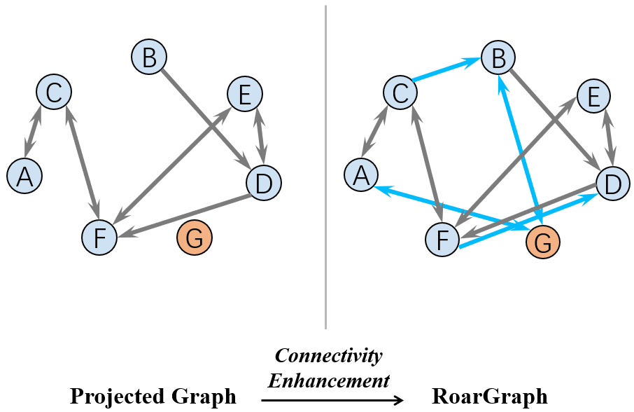
Connectivity Enhancement: make graph reachable and provide alternative paths
Projected Graph
RoarGraph
An example illustrating connectivity enhancement using 100 vectors.

Slide 21
Evaluation

Slide 22
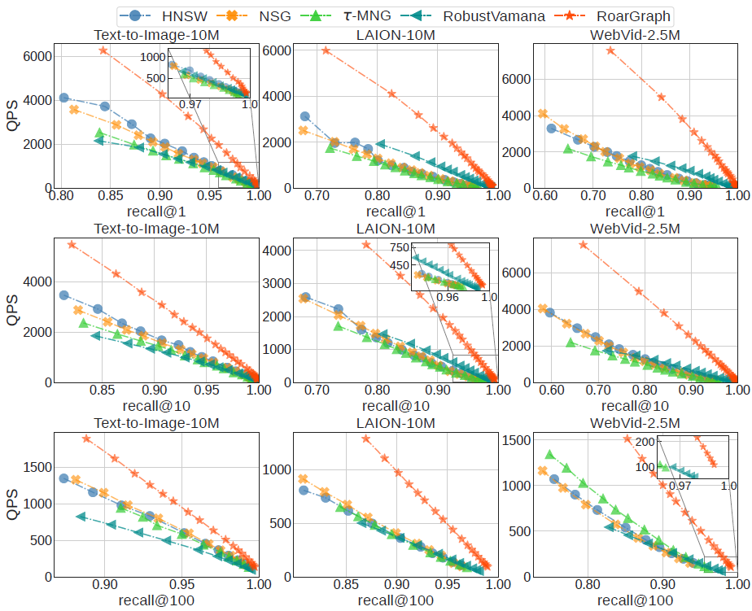
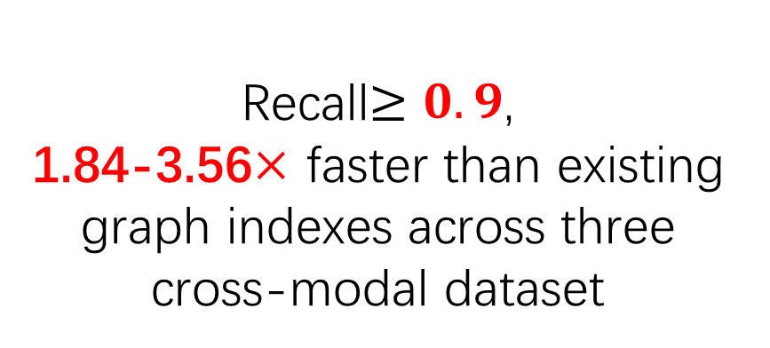
Performance: Recall vs. Search Speed
Text-Image / Text-Video Frame
Recall$≥0.9$,
1.84-3.56$×$ faster than existing graph indexes across three cross-modal dataset

Slide 23
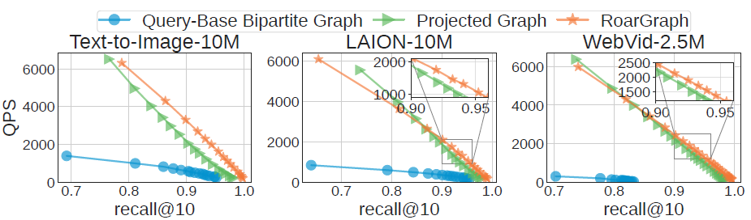
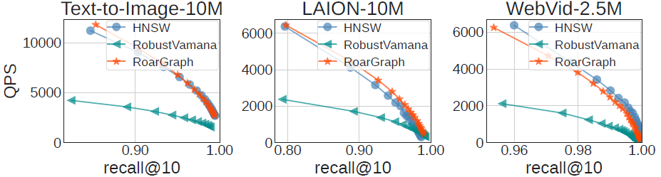
Ablation Study
Single-Modal Task Evaluation

Slide 24


Thanks! Q & A
Code: https://github.com/matchyc/RoarGraph
Contact: mengchen22@m.fudan.edu.cn

Slide 25
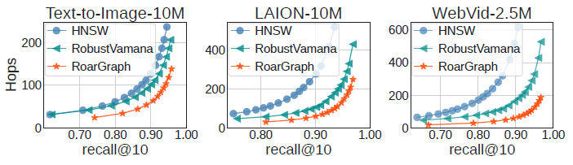
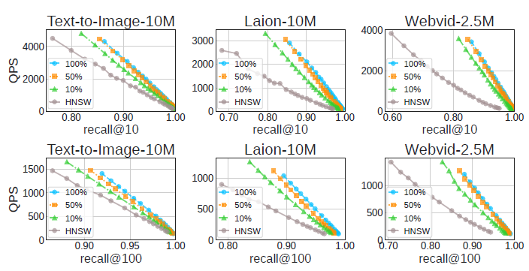

Slide 26
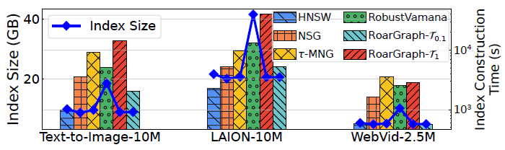
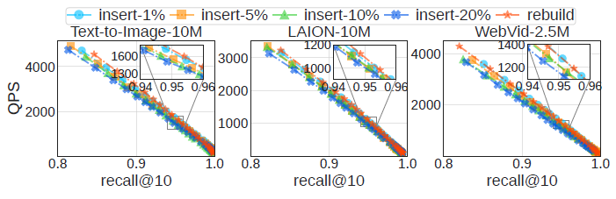

Slide 27
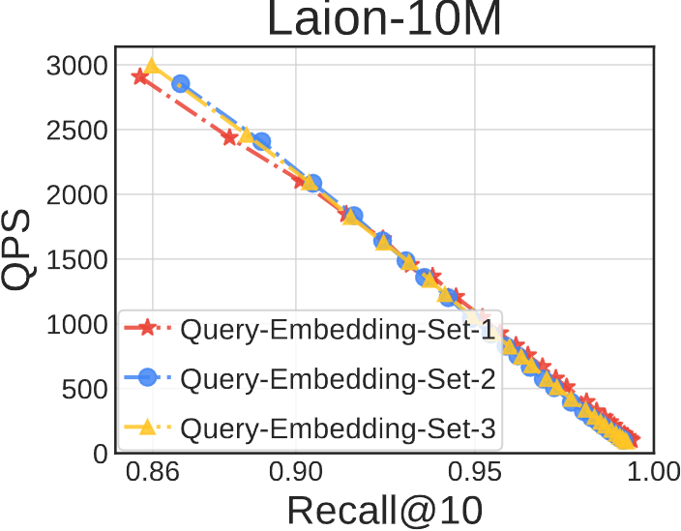

Slide 28
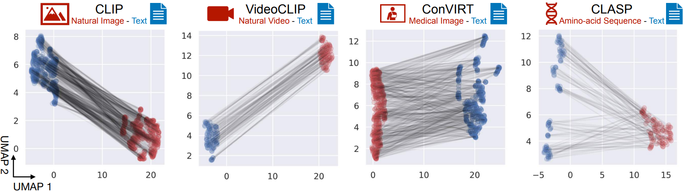
Challenge & Motivation
Modality Gap: a data distribution gap
Liang, Victor Weixin, et al.

